Slide 1
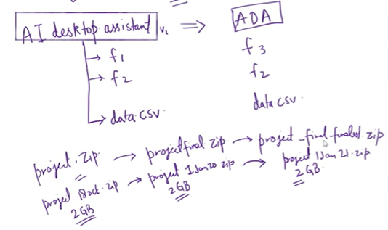
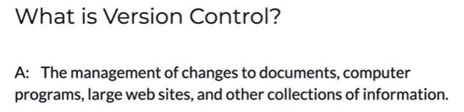
Git and Git Hub
Problems before Git
Why is git around?
Git is a version control system(VCS)
Easily recover files
Who introduced an issue and when
Roll back to previously working state

Slide 2
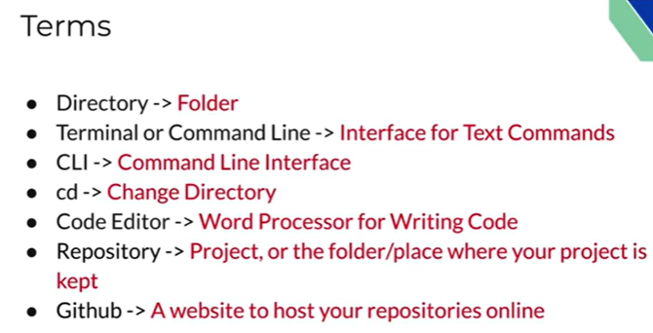
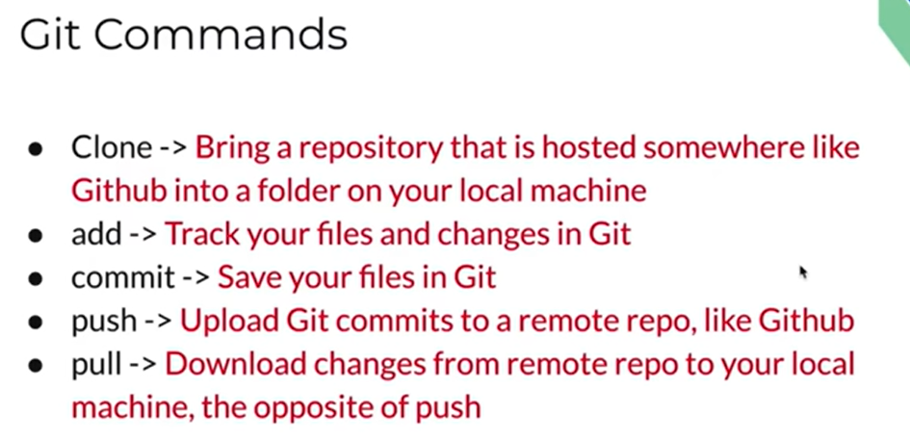

Slide 3
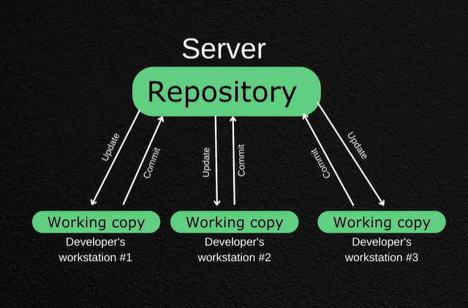












History of Vcs
Local VCS-Desktop to keep track of files
Pros-can track files and rollback
Cons-if you lose your hard disk, everything is lost
Centralized VCS

Slide 4
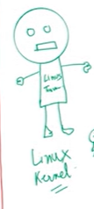
















Distributed VCS
If server lost anybody can deposit
And if any one lost data then can pull from server.
How was git created
1991-2002
2002-Bit keeper VCS
2002-2005
2005-Free of charge status was revoked

Slide 5
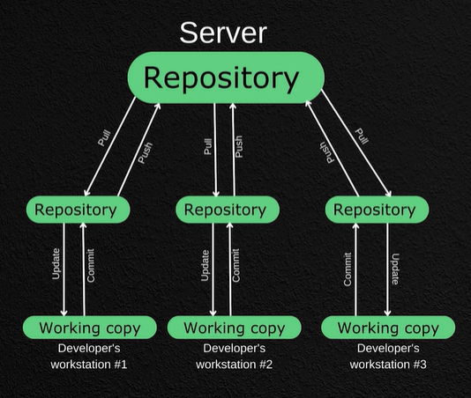






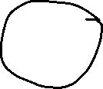


Git Features
Captures the Snapshot not difference
Almost every operation is local
Git has integrity
Git generally only adds data

Slide 6
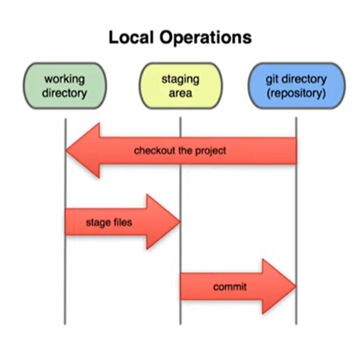
























Slide 7
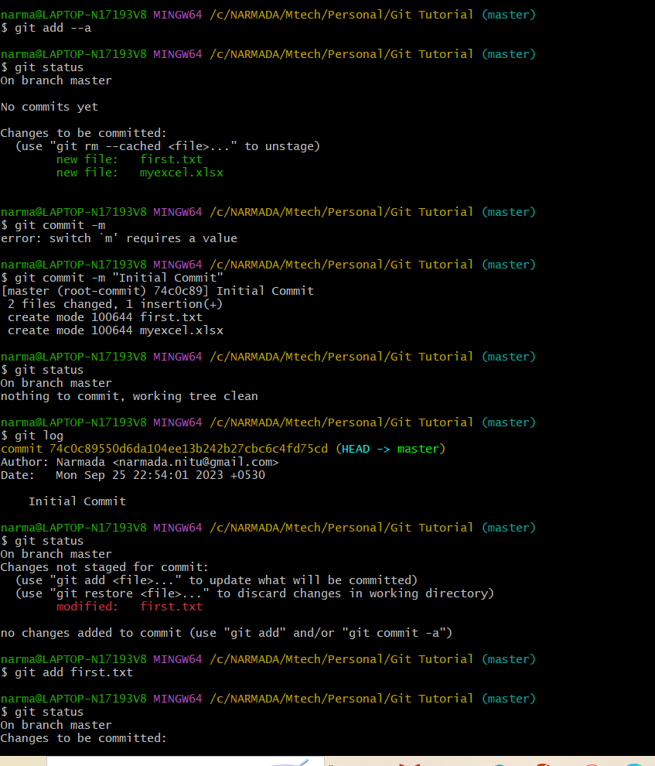
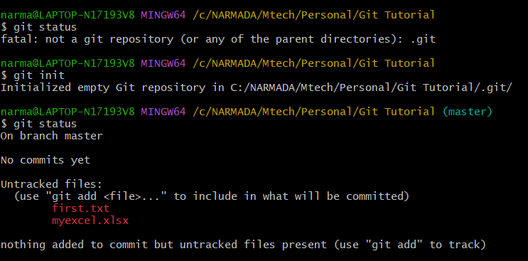
Checksum – 40 letter word , only first 7 letter show during commit
Git create checksum on every commit , so that it can track if there any changes by checking the checksum

Slide 8
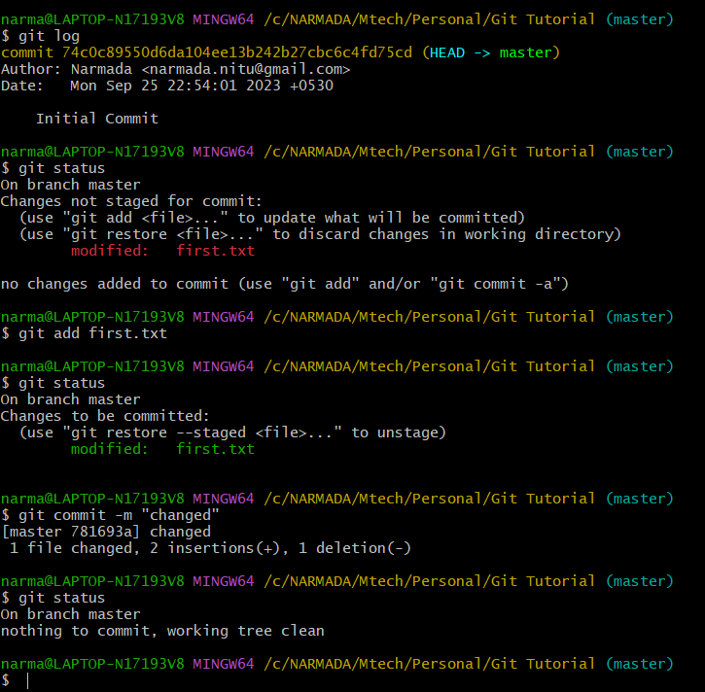

Slide 9
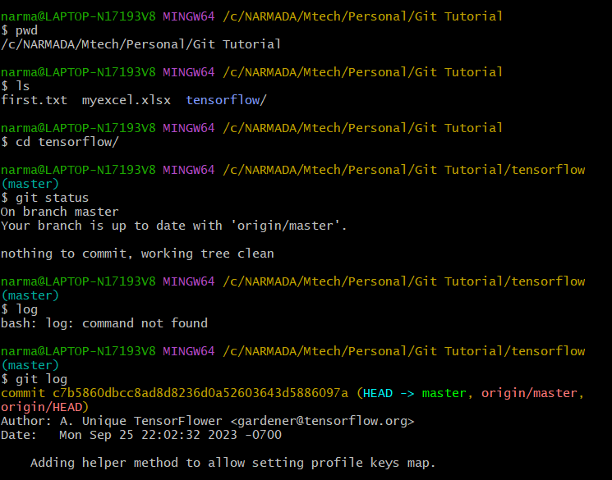

Slide 10
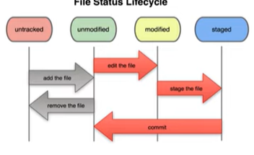



























Slide 11
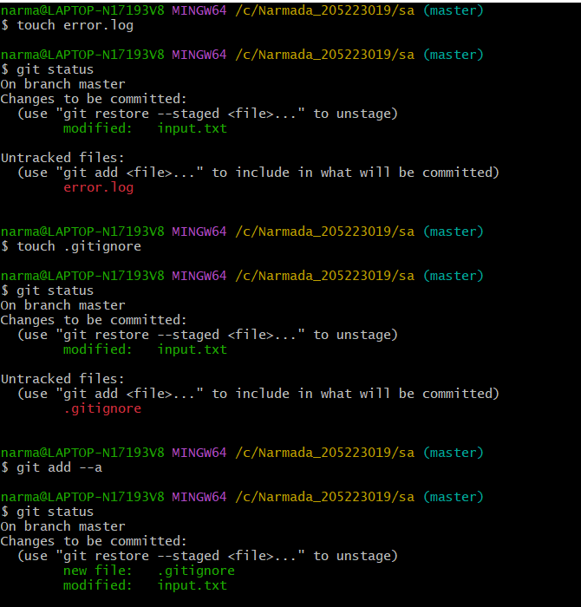
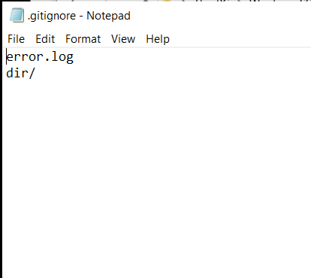












.gitignore: Ignoring Files in Git

Slide 12
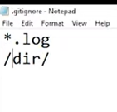














Slide 14
Pushing to github

